Slide 1
Start using data.table
Coffee and Coding 09/07/19
Megan Stodel

Slide 2
About data.table

Slide 3

Defining data.table
A package in R
  Originally released in 2006
  730k downloads a month
A data structure
A way of manipulating data

Slide 4
Why you should use data.table

Slide 5
Speed matters
Speed can be particularly important in some instances:
  Very big datasets
  Apps or tools designed for general use
  Code that you run often

Slide 6
data.table is fast
One of the most common criticisms of R is that it is slow
Not data.table!
  Things can be modified / altered by reference, so there is in-situ replacement without duplicating the table
  The binary search algorithm means it efficiently finds values by searching a small section of the sorted data
  You can perform numerous operations in one line, so don’t have to allocate memory for the intermediate result
  Speed extends to reading in data using fread()

Slide 7
Benchmarks
-- Aggregation benchmarks here –
Data.table is consistently substantially faster, not only than dplyr, but also pandas and data structures in other languages.
Relative performance increases as data size increases.

Slide 8
Few dependencies
DATA.TABLE
DPLYR
methods (base)
assertthat
glue
magrittr
pkgconfig
R6
Rcpp
rlang
tibble
tidyselect
utils (base)

Slide 9
Concise and consistent syntax
Code is often shorter
Consistent logic, once learnt, is straightforward and easy to apply for diverse needs – building blocks rather than individual functions
Different people will prefer different things
data.tables are data.frames – so can still use data.frame commands on them

Slide 10
Using data.table

Slide 11
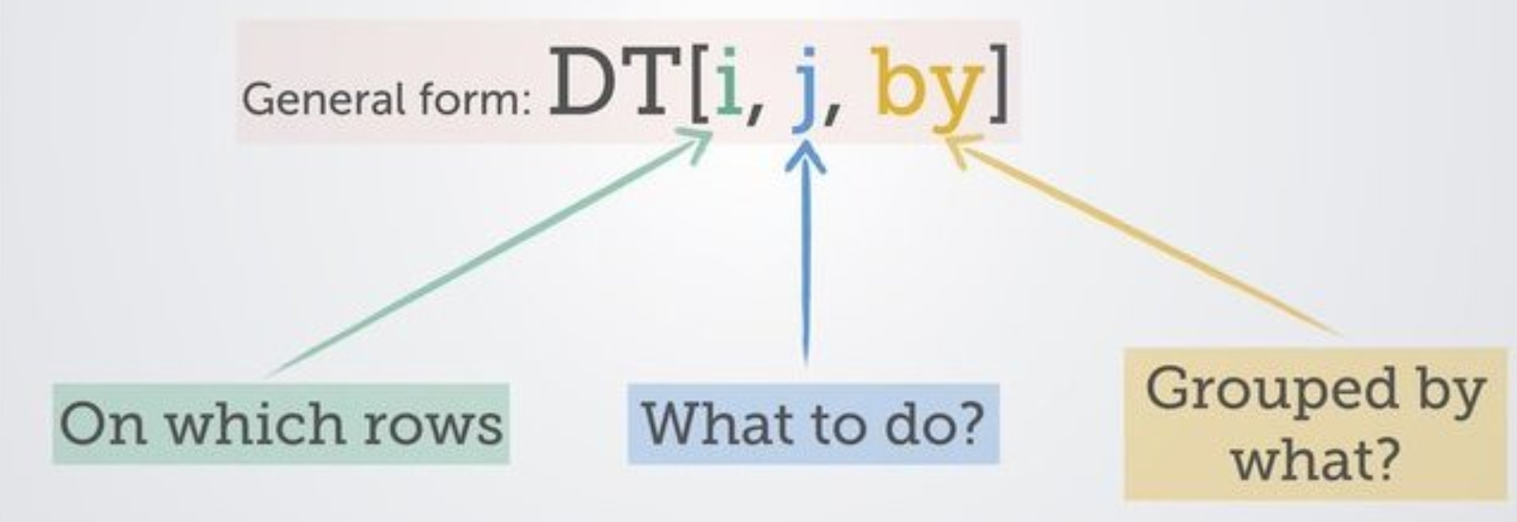
The syntax
(source)

Slide 12
In-situ definition and replacement
:=
This combination of characters is how to create or modify a column without needing to create a copy of the dataset.
DT[, bigger_number := number_column + 1]

Slide 13
Built-in variables
Symbol | Purpose
.N | Number of observations in the group DT[, .N] Counts the number of observations (rows) in the data.table
.SD | Subset of Data. A way of referencing all columns except the grouping columns. So rather than individually calling functions on each column, can use .SD to apply to all of them, used in conjunction with base function lapply(). DT[, lapply(.SD, mean)] Calculates the mean for every column

Slide 14
Lists in data.table
As long as j returns a list, each element of the list will become a column in the resulting data.table.
If you only want certain columns in your data.table, you can achieve this using a list, which in its short version is .()
twocol_DT <- DT[, .(column_a, column_b)]
This is true even if you want a one column data.table
onecol_DT <- DT[, .(column_a)]
If you don’t have your single column in a list, it will become a vector (which is often useful)
vector <- DT[, column_a]

Slide 15
Changing column names
Rename by reference with setnames()
setnames(DT, “original_name”, “new_name”)
setnames(DT, c(“a”, “b”, “c”), c(“A”, “B”, “C”))
Or change names as you choose which columns to keep
new_DT <- DT[, .(new_name = old_name,
new_column = old_column)]

Slide 16
Chaining
Similar to piping, you can chain data.table commands
DT[, .N, by = month][order(-N)][1:3]

Slide 17
What is happening here?
DT[year == 2018, profit := sales – spend]
Filter the data.table to rows where the year value is 2018
Create a new column called “profit” that calculates the result of the number in the “sales” column minus the number in the “spend” column
(nothing in the “by” column)

Slide 18
What is happening here?
DT[, .N, by = location]
Not filtering by anything (but need the comma)
Count the number of rows
Do this action for each distinct “location”

Slide 19
Your turn!

Slide 20
Exercises
Set up with the following code:
Which diet is being fed to the most chicks?
What is the average (mean) weight of a chick at time 21 for each diet?
Add a new column that is TRUE when weight is 100 or more.
Make every column a character class.
Rename the columns (to anything you like).
# install.packages(data.table)
library(data.table)
chick_weight <- as.data.table(ChickWeight)
If watching this later, find the solutions in the repo:
https://github.com/moj-analytical-services/
coffee-and-coding-public

Slide 21
Useful resources
data.table site
data.table FAQ
A data.table and dplyr tour (includes comparison of operations in both packages)
Advanced tips and tricks with data.table (this is so good!)

Slide 22
Questions?
Suggestions for future sessions?

